Slide 1
Registration and Login
Spring Security, Spring Data JPA, Hibernate, MySQL, Thymeleaf, Bootstrap, Translations

Slide 2
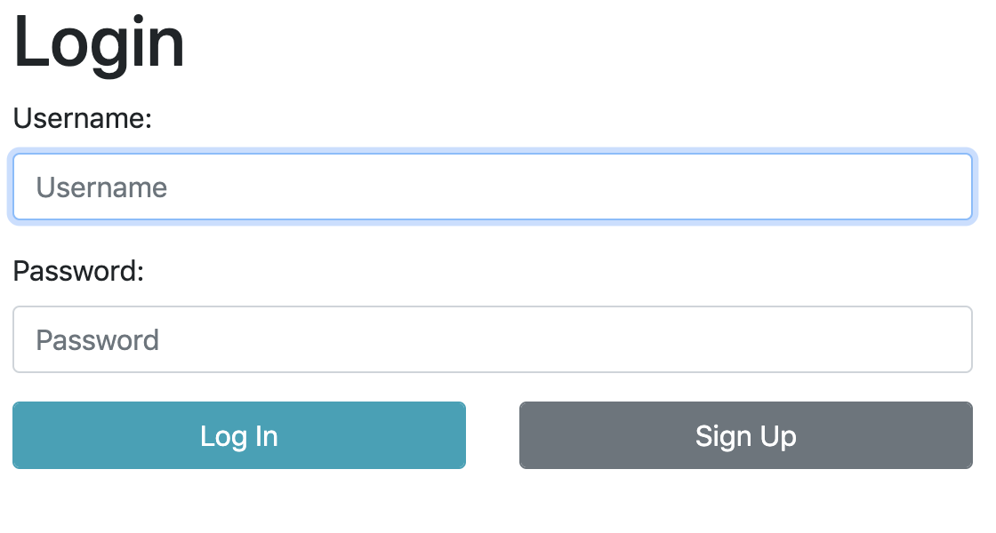
Login Page

Slide 3
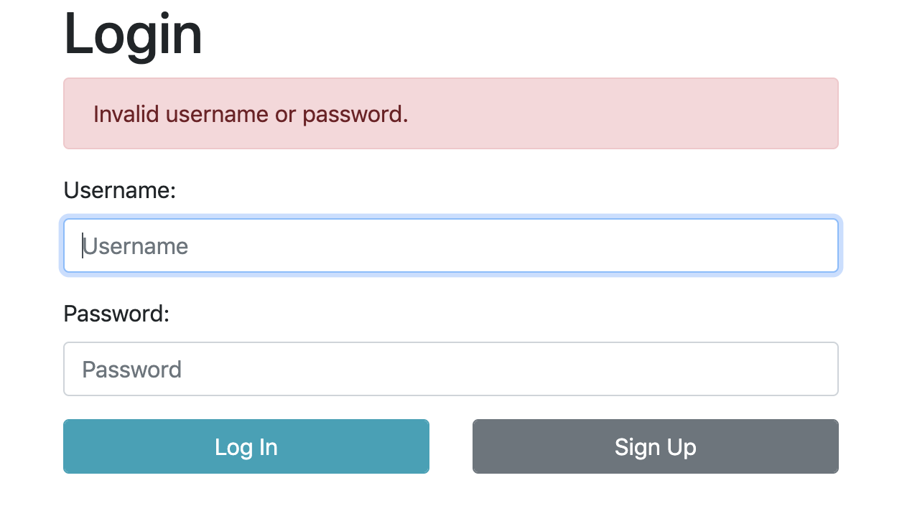
Login Page Validation

Slide 4
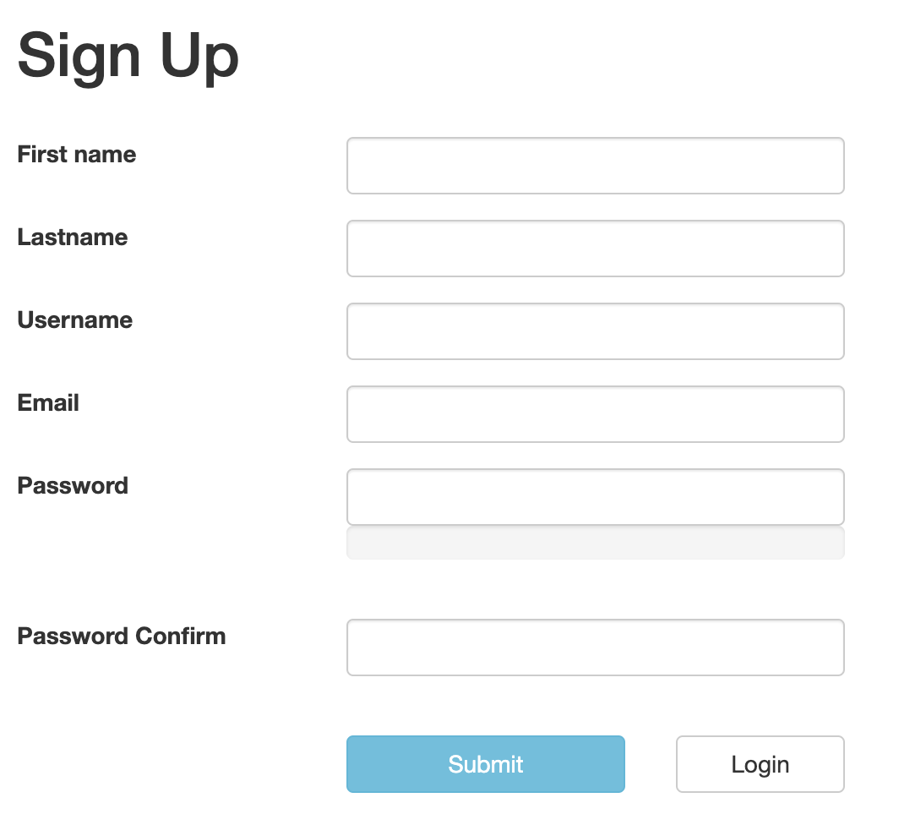
Registration

Slide 5
Project Dependencies
<!-- Password Validation -->
<dependency>
<groupId>org.passay</groupId>
<artifactId>passay</artifactId>
<version>1.0</version>
</dependency>

Slide 6
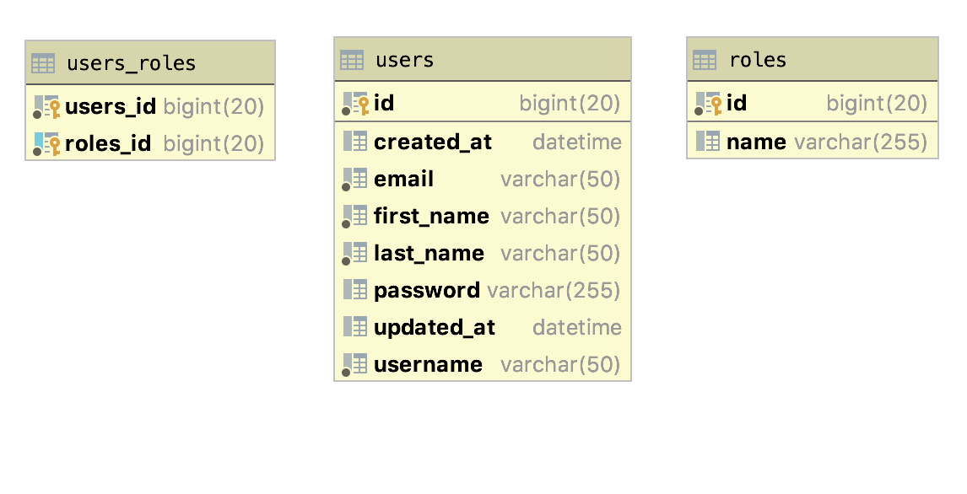
Database Visualization

Slide 7
Hibernate Entities - User Entity
@Column(length = 50, nullable = false)
private String username;
@Column(length = 50, nullable = false)
private String email;
private String password;
@Transient
private String passwordConfirm;

Slide 8
Hibernate Entities - Role Entity
@Entity
@Table(name = "roles")
public class Role {
@Id
@GeneratedValue(strategy = GenerationType.IDENTITY, generator = "native")
private Long id;
private String name;
@ManyToMany(mappedBy = "roles")
private Set<User> users;

Slide 9
Repositories - UserRepository
public interface UserRepository extends CrudRepository<User, Long> {
Iterable<User> findTop1ByFirstName(String firstName);
Iterable<User> findTop10ByLastName(String lastName);
Iterable<User> findTop10ByFirstNameAndLastName(String firstName, String lastName);
@Query(nativeQuery = true, value = "SELECT * FROM users limit 1")
Iterable<User> findAllTopTen();
Iterable<User> findByFirstName(String firstName);
User findOneByUsername(String username);
}

Slide 10
Repositories - RoleRepository
public interface RoleRepository extends JpaRepository<Role, Long> {
}

Slide 11
Spring Security UserDetailsService
To implement login/authentication with Spring Security, we need to implement org.springframework.security.core.userdetails.UserDetailsService interface
public interface UserDetailsService {
*
* @param username the username identifying the user whose data is required.
*
* @return a fully populated user record (never <code>null</code>)
*
* @throws UsernameNotFoundException if the user could not be found or the user has no
* GrantedAuthority
*/
UserDetails loadUserByUsername(String username) throws UsernameNotFoundException;
}

Slide 12
Spring Security UserDetailsService Implementation
@Service
public class UserDetailsServiceImpl implements UserDetailsService {
@Autowired
UserRepository userRepository;
@Override
@Transactional(readOnly = true)
public UserDetails loadUserByUsername(String username) throws UsernameNotFoundException {
User user = userRepository.findOneByUsername(username);
if (user == null) {
throw new UsernameNotFoundException(username);
}
Set<GrantedAuthority> grantedAuthorities = new HashSet<>();
for (Role role : user.getRoles()) {
grantedAuthorities.add(new SimpleGrantedAuthority(role.getName()));
}
return new org.springframework.security.core.userdetails.User(user.getUsername(), user.getPassword(), grantedAuthorities);
}
}

Slide 13
Security Service Interface
package com.nursultanturdaliev.moneytransferapp.services;
public interface SecurityService {
String findLoggedInUsername();
public void autoLogin(String username, String password);
}

Slide 14
SecurityServiceImpl
@Service
public class SecurityServiceImpl implements SecurityService {
@Override
public void autoLogin(String username, String password) {
UserDetails userDetails = userDetailsService.loadUserByUsername(username);
UsernamePasswordAuthenticationToken usernamePasswordAuthenticationToken = new UsernamePasswordAuthenticationToken(userDetails, password, userDetails.getAuthorities());
authenticationManager.authenticate(usernamePasswordAuthenticationToken);
if (usernamePasswordAuthenticationToken.isAuthenticated()) {
SecurityContextHolder.getContext().setAuthentication(usernamePasswordAuthenticationToken);
logger.debug(String.format("Auto login %s successul!", username));
}
}
}
https://gist.github.com/nursultanturdaliev/215526d740c8f208b6085655bcebd9ea

Slide 15
UserService Interface
package com.nursultanturdaliev.moneytransferapp.services;
import com.nursultanturdaliev.moneytransferapp.model.User;
public interface UserService {
void save(User user);
User findOneByUsername(String username);
}

Slide 16
UserService Implementation
@Service
public class UserServiceImpl implements UserService {
@Override
public void save(User user) {
user.setPassword(bCryptPasswordEncoder.encode(user.getPassword()));
user.setFirstName(user.getFirstName());
user.setLastName(user.getLastName());
user.setEmail(user.getEmail());
user.setUsername(user.getUsername());
user.setRoles(new HashSet<>(roleRepository.findAll()));
userRepository.save(user);
}
@Override
public User findOneByUsername(String username) {
return userRepository.findOneByUsername(username);
}

Slide 17
Spring Validator
@Component
public class UserValidator implements Validator {
@Autowired
private UserService userService;
@Override
public boolean supports(Class<?> aClass) {return User.class.equals(aClass); }
@Override
public void validate(Object o, Errors errors) {
User user = (User) o;
ValidationUtils.rejectIfEmptyOrWhitespace(errors, "password", "NotEmpty");
if (user.getPassword().length() < 8 || user.getPassword().length() > 32) {
errors.rejectValue("password", "Size.userForm.password");
}
if (!user.getPasswordConfirm().equals(user.getPassword())) {
errors.rejectValue("passwordConfirm", "Diff.userForm.passwordConfirm");
}
}
}

Slide 18
Registration Controller
@GetMapping("/registration")
public String registration(Model model) {
model.addAttribute("user", new User());
return "registration";
}
@PostMapping("/registration")
public String registration(@ModelAttribute("user") User user, Errors errors) {
userValidator.validate(user, errors);
if (errors.hasErrors()) {
return "registration";
}
userService.save(user);
securityService.autoLogin(user.getUsername(), user.getPasswordConfirm());
return "redirect:/";
}
@GetMapping("/login")
public String login() {
return "login";
}

Slide 19
Registration Template
https://gist.github.com/nursultanturdaliev/a4cfc17e5d4db40976e4590ce22f7d45

Slide 20
Login Template
https://gist.github.com/nursultanturdaliev/5d5b2a2c5df7e3f0b241f4d713e4e2da

Slide 21
Web Security Configuration
@Override
protected void configure(HttpSecurity http) throws Exception {
http
.csrf().disable()
.authorizeRequests()
.antMatchers("/resources/**", "/registration", "/error").permitAll()
.anyRequest().authenticated()
.and()
.formLogin()
.loginPage("/login")
.permitAll()
.and()
.logout()
.permitAll();
}

Slide 22
Web Security Configuration
@Bean
public BCryptPasswordEncoder bCryptPasswordEncoder() {
return new BCryptPasswordEncoder();
}
@Autowired
public void configureGlobal(AuthenticationManagerBuilder auth) throws Exception {
auth.userDetailsService(userDetailsService).passwordEncoder(bCryptPasswordEncoder());
}

Slide 23
Translations - messages.properties
label.user.firstName=First name
label.user.lastName=Lastname
label.user.username=Username
label.user.email=Email
label.user.password=Password
label.user.confirmPass=Password Confirm
label.form.submit=Submit
label.form.loginLink=Login
label.form.title=Sign Up
error.wordLength=Your password is too short
error.wordNotEmail=Do not use your email as your password
error.wordSequences=Your password contains sequences
error.wordLowercase=Use lower case characters
error.wordUppercase=Use upper case characters
error.wordOneNumber=Use numbers
error.wordOneSpecialChar=Use special characters
PasswordMatches.user=Password does not match!
NotEmpty=This field is required.
Size.userForm.username=Please use between 6 and 32 characters.
Duplicate.userForm.username=Someone already has that username.
Size.userForm.password=Try one with at least 8 characters.
Diff.userForm.passwordConfirm=These passwords don't match.

Slide 24
References
https://stackoverflow.com/questions/14014086/what-is-difference-between-crudrepository-and-jparepository-interfaces-in-spring
https://medium.com/@devquora/login-registration-example-with-spring-boot-f5f76459c59d
https://www.baeldung.com/transaction-configuration-with-jpa-and-spring
https://spring.io/guides/gs/handling-form-submission/

